Slide 1
MINISTRY OF HEALTH OF UKRAINE NATIONAL UNIVERSITY OF PHARMACY
DEPARTMENT OF MANADEMENT, MARKETING AND QUALITY ASSURANCE IN PHARMACY
DIGITAL MARKETING TOOLS
SELECTIVE EDUCATIONAL COMPONENT
for specialty
«Pharmacy, industrial pharmacy»

Slide 2
Digital marketing is a type of marketing activity that involves the use of various forms of digital channels to interact with consumers and other counterparties in the market
The main channels of Digital Marketing include:
the Internet and devices that provide access to it (personal computers, laptops, tablets, smartphones)
mobile communications and mobile devices,
cell phone applications
local networks (Extranet, Intranet)
digital television
interactive screens, POS-terminals

Slide 3
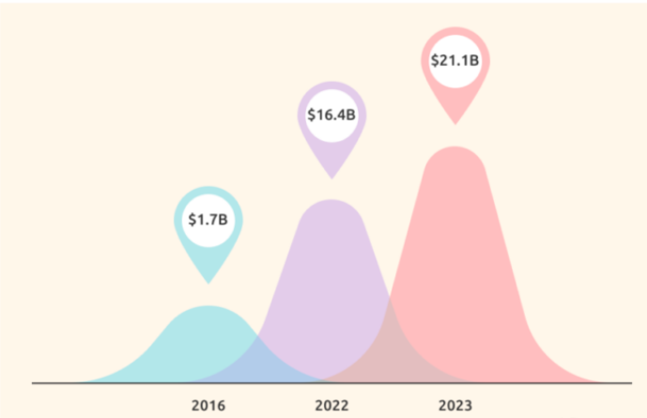
Globally, about 41% of consumers discover new products at least once a week through opinion leaders (bloggers)
71% of users decide to buy on the recommendations of social media, a significant proportion of these recommendations belong to bloggers
Every dollar invested in social media development brings in up to $ 6.5 in profit
Dynamics of influencer marketing costs at the global level, billion USD

Slide 4
Educational component “Digital Marketing Tools”
consist of two topic modules:
Digital marketing as a modern means of promoting companies, goods and services
Digital tools of marketing communications in the pharmaceutical market

Slide 5
In this educational component you will…
Explore theoretical and practical issues of digital marketing
1
Develop the knowledge, skills and competencies needed to organize effective activities to promote companies and products through digital channels
2
3
Learn to solve specific marketing problems of pharmaceutical companies and pharmacy networks in the digital environment

Slide 6
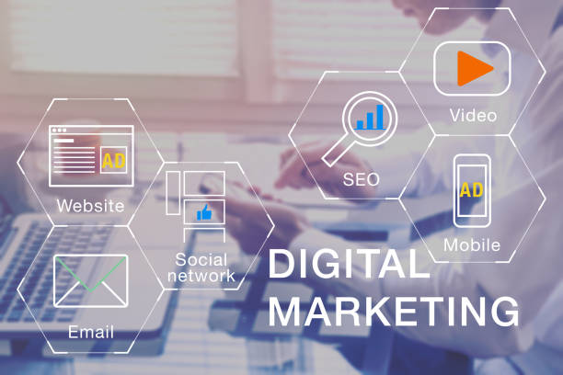
YOU WILL LEARN ABOUT:
Features of consumer behavior when searching and buying on the Internet
Directions and tools of digital marketing
Trends in digital marketing

Slide 7
You will be aware of:
Cases of pharmaceutical companies on the use of social networks and influence marketing with the involvement of bloggers
Cases of pharmacy networks on the use of digital channels for the promotion of pharmacy products
Influence marketing
Social media
Chat bots
Е-mail marketing

Slide 8
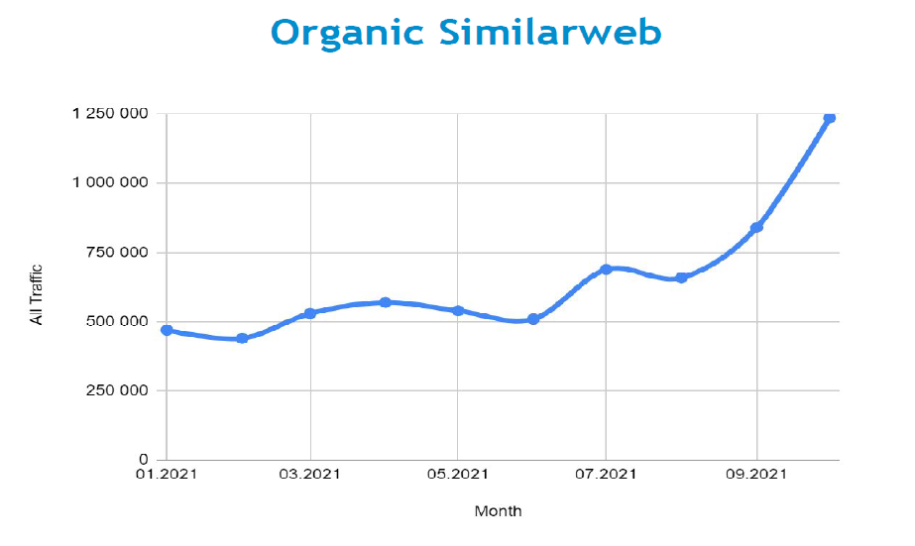
You will be able:
To collect and analyze data to solve problems in the field of digital marketing
To form new competitive ideas on the strategy of promoting companies, goods and services in the digital environment
Evaluate the effectiveness and efficiency of advertising campaigns using digital marketing

Slide 9
We are waiting for You and wish You success!

